Slide 1
Simple Car Parking System

Slide 2

MQTT
In this project we will use MQTT.
MQTT stands for Message Queuing Telemetry Transport.
We used in this project because it is:
Simple
Reliable
Secure

Slide 3
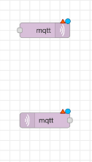
MQTT implementation
In node red we will use a mqtt out and mqtt in node

Slide 4
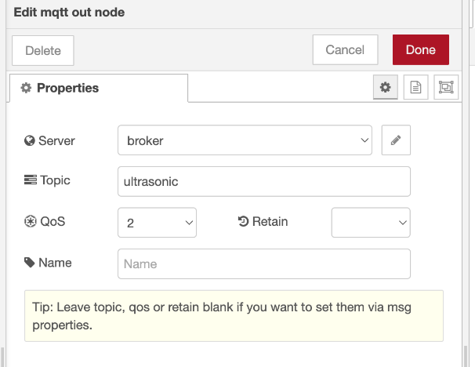
MQTT-Out

Slide 5
MQTT-out
Qos stands for quality of service.
Qos is an agreement between sender and receiver on the guarantee of delivering a message. There are three levels of QoS: 0 - at most once. 1 - at least once. 2 - exactly once.
Qos was set to 2.

Slide 6
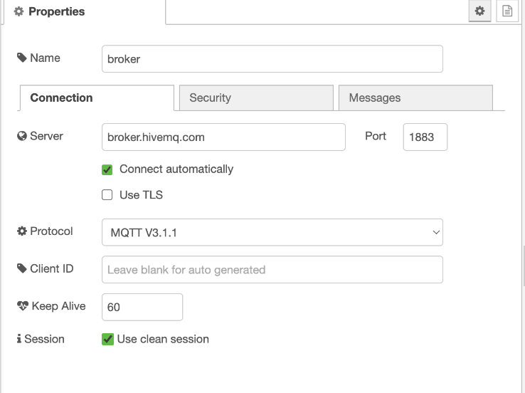
MQTT-out

Slide 7
MQTT-out
The server that was selected was broker.hivemq.com
This server is an open-source server that can run
The port was set to 1883
The topic was set to ultrasonic

Slide 8

MQTT-in
The same that was applied in MQTT-out was done in mqtt-in

Slide 9


Slide 10
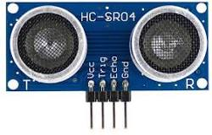
Ultrasonic sensor
In order to measure distance in this project we will use HC sR04.This is an ultrasonic sensor

Slide 11
Ultrasonic sensor important notes
Ultrasonic sensors emit a chirp usually between 23 kHz and 40 kHz, much higher than the typical audible range of human hearing at 20 kHz, hence the term ultrasonic
According to the datasheet of the manufacturer, this module can measure distance ranging from 2 cm to 254 cm
We will use 2 sensors from this module.One for the rear and one for the front side.Primary objective is to measure the distance in front and backward of the sensor and display that to the user.

Slide 12
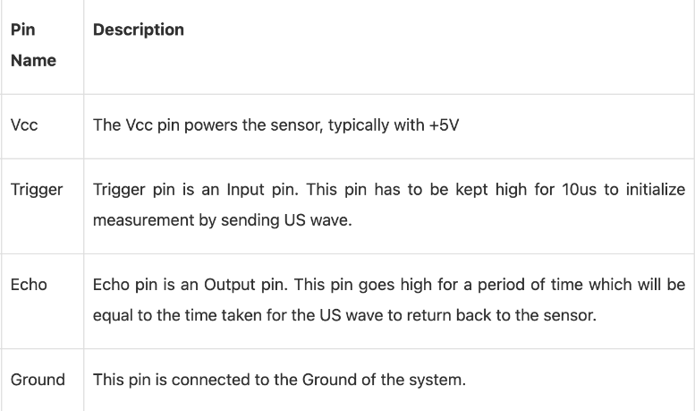
Pins function

Slide 13
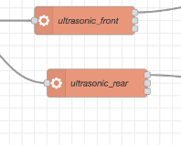
Implementation
In order to implement this part, we will use an execute node.

Slide 14
Ultrasonic code
We will write this code using python programming language
After writing the file we will call it using the execute node.
Simply fill the first field in this node with the file path .

Slide 15
Theory of operation of the ultrasonic sensor
Ultrasonic sensors emit short, high-frequency sound pulses at regular intervals. These propagate in the air at the velocity of sound. If they strike an object, then they are reflected back as echo signals to the sensor, which itself computes the distance to the target based on the time-span between emitting the signal and receiving the echo . The principle of ultrasonic rangefinders is to measure the time it takes the signal sent by a transmitter and propagated back to the receiver . Ultrasonic sensors work by emitting sound waves at a frequency too high for humans to hear. They then wait for the sound to be reflected back, calculating distance based on the time required. This is similar to how radar measures the time it takes a radio wave to return after hitting an object .

Slide 16
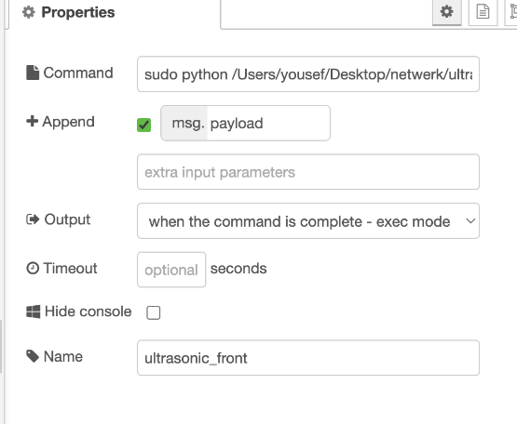
Execute node properties

Slide 17
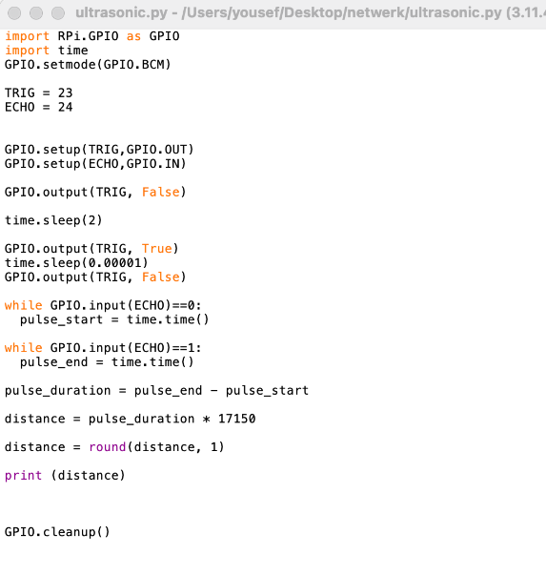
Explaining the code

Slide 18
Firstly import all the necessary libraries:
import RPi.GPIO as GPIO
import time

Slide 19
Pins declaration
Firstly there are 3 modes for pins numbering in raspberry pi 4
PIN: 1 to 40 logical order of the pin
BCM: the number to be used in your Java code to specify the GPIO to be used. BCM refers to the “Broadcom SOC channel” number, which is the numbering inside the chip which is used on the Raspberry Pi. These numbers changed between board versions as you can see in the previous tables for the 26-pin header type 1 versus 2, and or not sequential.
WPI: WiringPi number which was used by V.1 of Pi4J. The WiringPi numbering has a “historical reason”. When development for the very first Raspberry Pi’s was ongoing, only 8 pin-numbers were foreseen. But, when the designs further evolved and more pins were added, the numbering in WiringPi was extended to be able to address the extra pins.
In this project we will use BCM

Slide 20
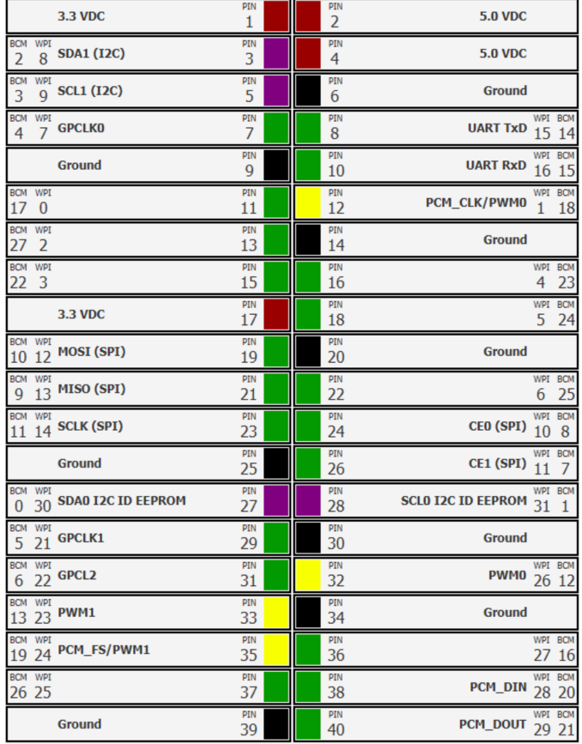

Slide 21
Pins declaration
# Set the mode of the GPIO pins
GPIO.setmode(GPIO.BCM)
# Define the GPIO pins for the ultrasonic sensor
TRIG = 23
ECHO = 24
# Set the GPIO pins as output and input
GPIO.setup(TRIG, GPIO.OUT)
GPIO.setup(ECHO, GPIO.IN)

Slide 22
# Set the TRIG pin to LOW
GPIO.output(TRIG, False)
# Wait for 2 seconds
time.sleep(2)

Slide 23
# Send a 10 microsecond pulse to the TRIG pin
GPIO.output(TRIG, True)
time.sleep(0.00001)
GPIO.output(TRIG, False)

Slide 24
# Measure the duration of the ECHO pin
while GPIO.input(ECHO) == 0:
pulse_start = time.time()
if GPIO.input(ECHO) == 1:
pulse_end = time.time()

Slide 25
# Calculate the distance using the speed of sound
pulse_duration = pulse_end - pulse_start
distance = pulse_duration * 17150
distance = round(distance, 1)
# Print the distance
print(distance)
# Clean up the GPIO pins
GPIO.cleanup()

Slide 26
Javascript code
We have tried to write the ultrasonic code using javascript.This is the code we wrote.
The aim was to write a function in javascript and put it in the function node in node red.

Slide 27
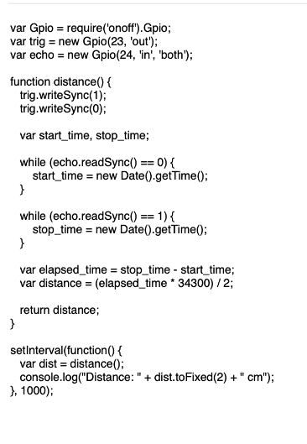
Javascript code

Slide 28
Debugging the JS code
The problem with this code is that to import the necessary libraries ,javascript syntax restricts us to require.
However,node-red documentation clearly states that you can use require in a function
This code outputs a reference error.
Reference error :’require ‘ is not defined

Slide 29
We have tried to fix it
We tried to use module.exports(‘require’) to fix that reference error
However, it outputted a type error.

Slide 30
Another approach
Also an approach that was used but fails, was to use the built in node that handles HC_SR4 but just giving it the pins.
However it gave an error gpio-status not available.
After reading the documentation,this node has been disabled from the publisher and last time updates was 2 years ago.Therefore, in most cases it does not work and is not recommended to use it according to the node-red community.

Slide 31
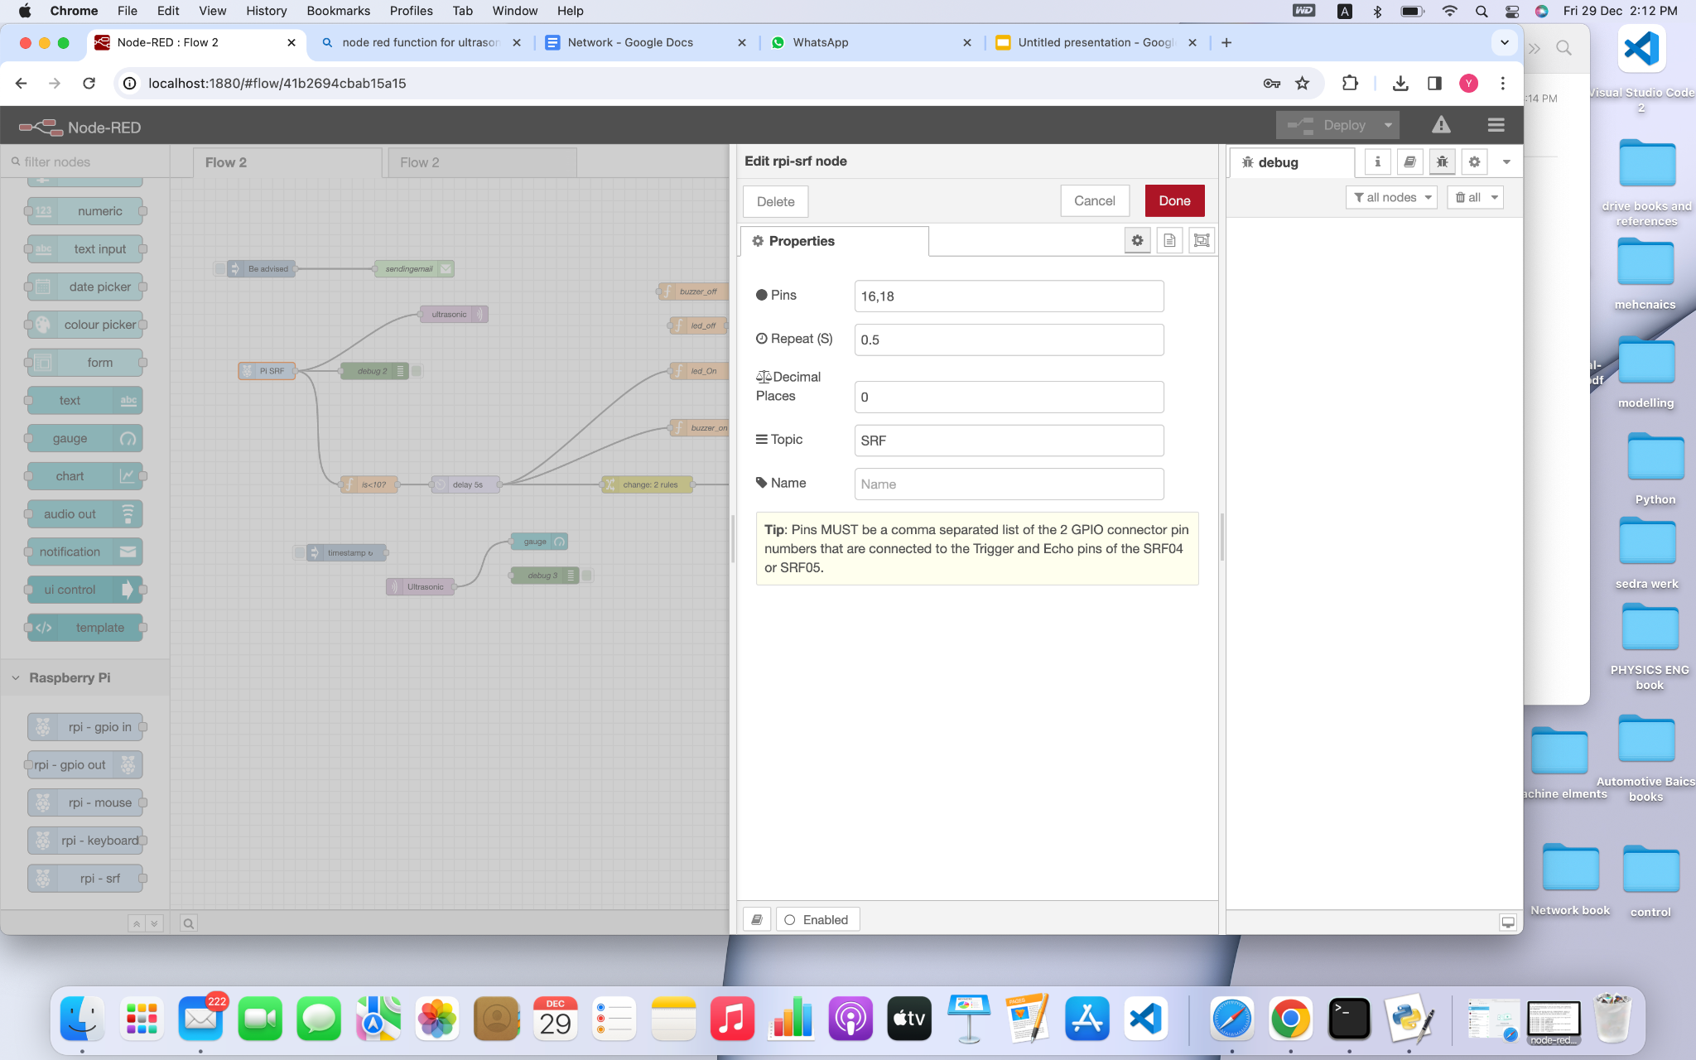
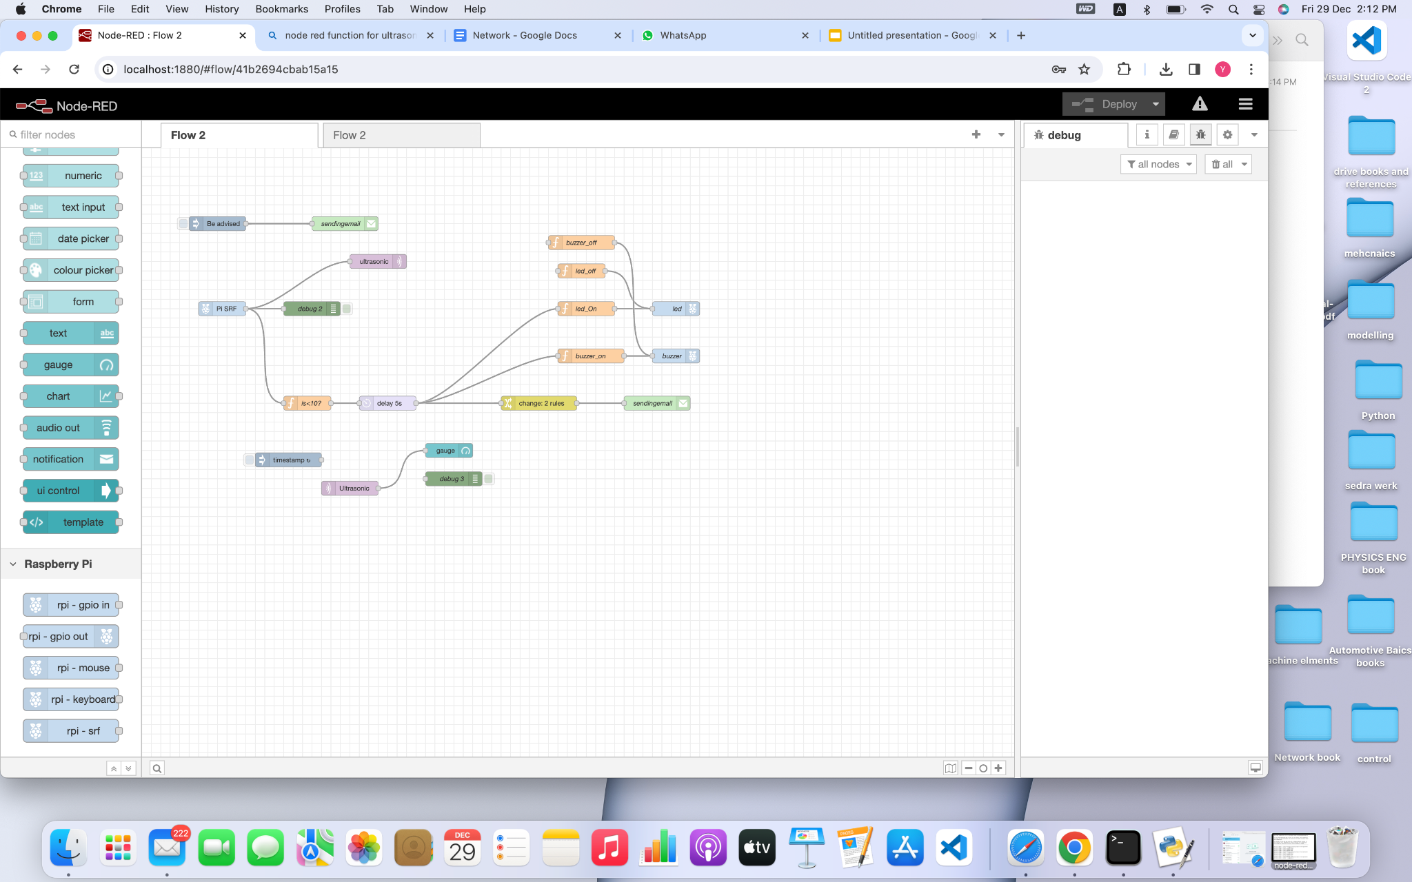

Slide 32
Logic after the ultrasonic
Now after the ultrasonic finishes its reading,we need to use its value to print on the dashboard.
However there is an issue
The execute node output is a string and the gauge node can only understand numbers.Data type of int/float precisely is needed
So we need to convert the msg.payload from string to int using javascript

Slide 33
Code
msg.payload = Number(msg.payload);
if(msg.payload>100)
{
msg.payload=100;
return msg;
}
else
{
return msg;
}

Slide 34
msg.payload = Number(msg.payload); // Convert the payload to a number
if(msg.payload>100) // Check if the payload is greater than 100
{
msg.payload=100; // If the payload is greater than 100, set it to 100
return msg; // Return the message
}
else
{
return msg; // If the payload is less than or equal to 100, return the message as is
}

Slide 35
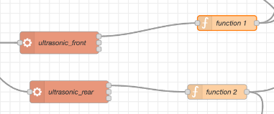

Slide 36

Now we can send the data to MQTT
We need to send the msg.payload to the mqtt broker to print it on the gauge in the dashboard.
Firstly get the data then send it.

Slide 37

Getting the data

Slide 38
Sending the data to the MQTT to the gauge

Slide 39
Dashboard
We added 2 gauges from the dashboard nodes

Slide 40
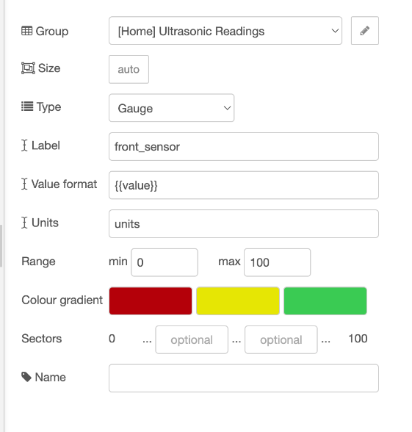
Gauge settings

Slide 41
Notice
The ultrasonic sensor reads the distance from 2 cm to 254 cm.However,we only want to show the user the max distance to be 100 cm.
This is because we want the gauge to be as clear as possible to the user.
Therefore we will limit the distance from 0 cm as a minimum to 100 cm as a maximum.

Slide 42
Then we need to connect to node-red to display the data
Using the command ipconfig in the raspberry pi 4 we got the IP address.
Then on the computer we wrote :
http://192.168.235.240:1880
That's the IP address of the raspberry pi plus the port of the localhost

Slide 43
Connection
All connections were made on a breadboard and using female-female jumper wire.
Ultrasonic sensor were tested accordingly separately to make sure that each one works .
Debug nodes were used for testing.

Slide 44
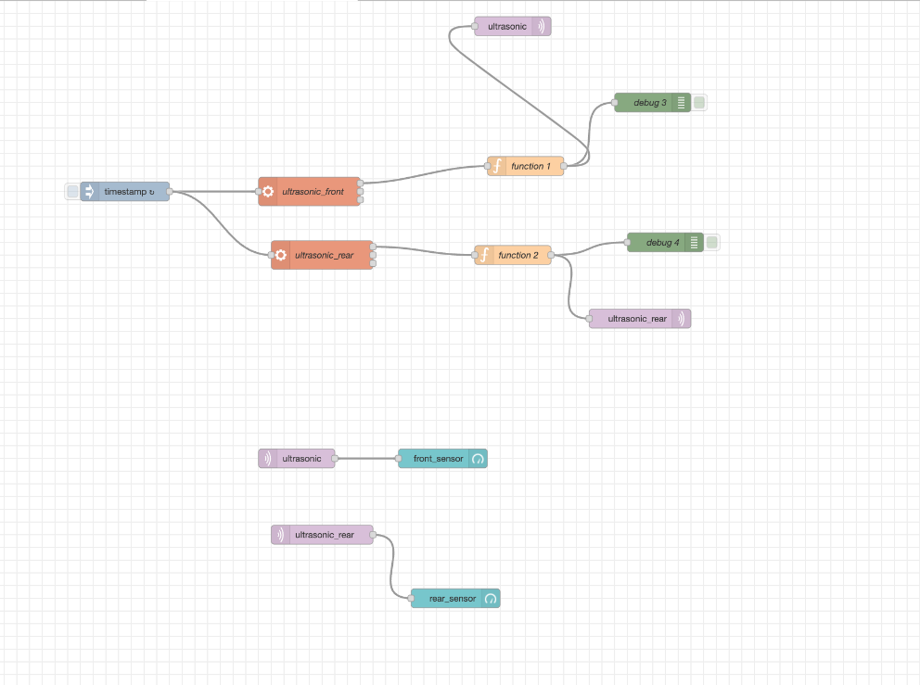
Final node-red

Slide 45
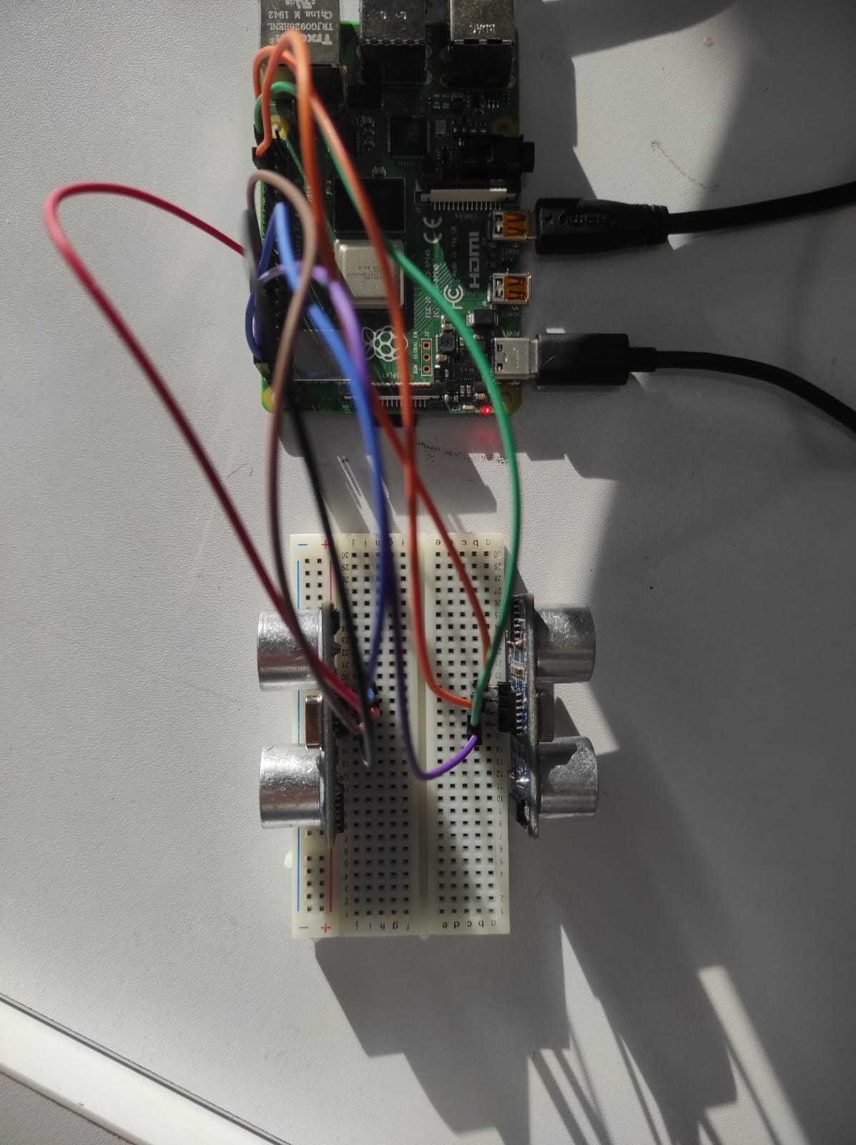
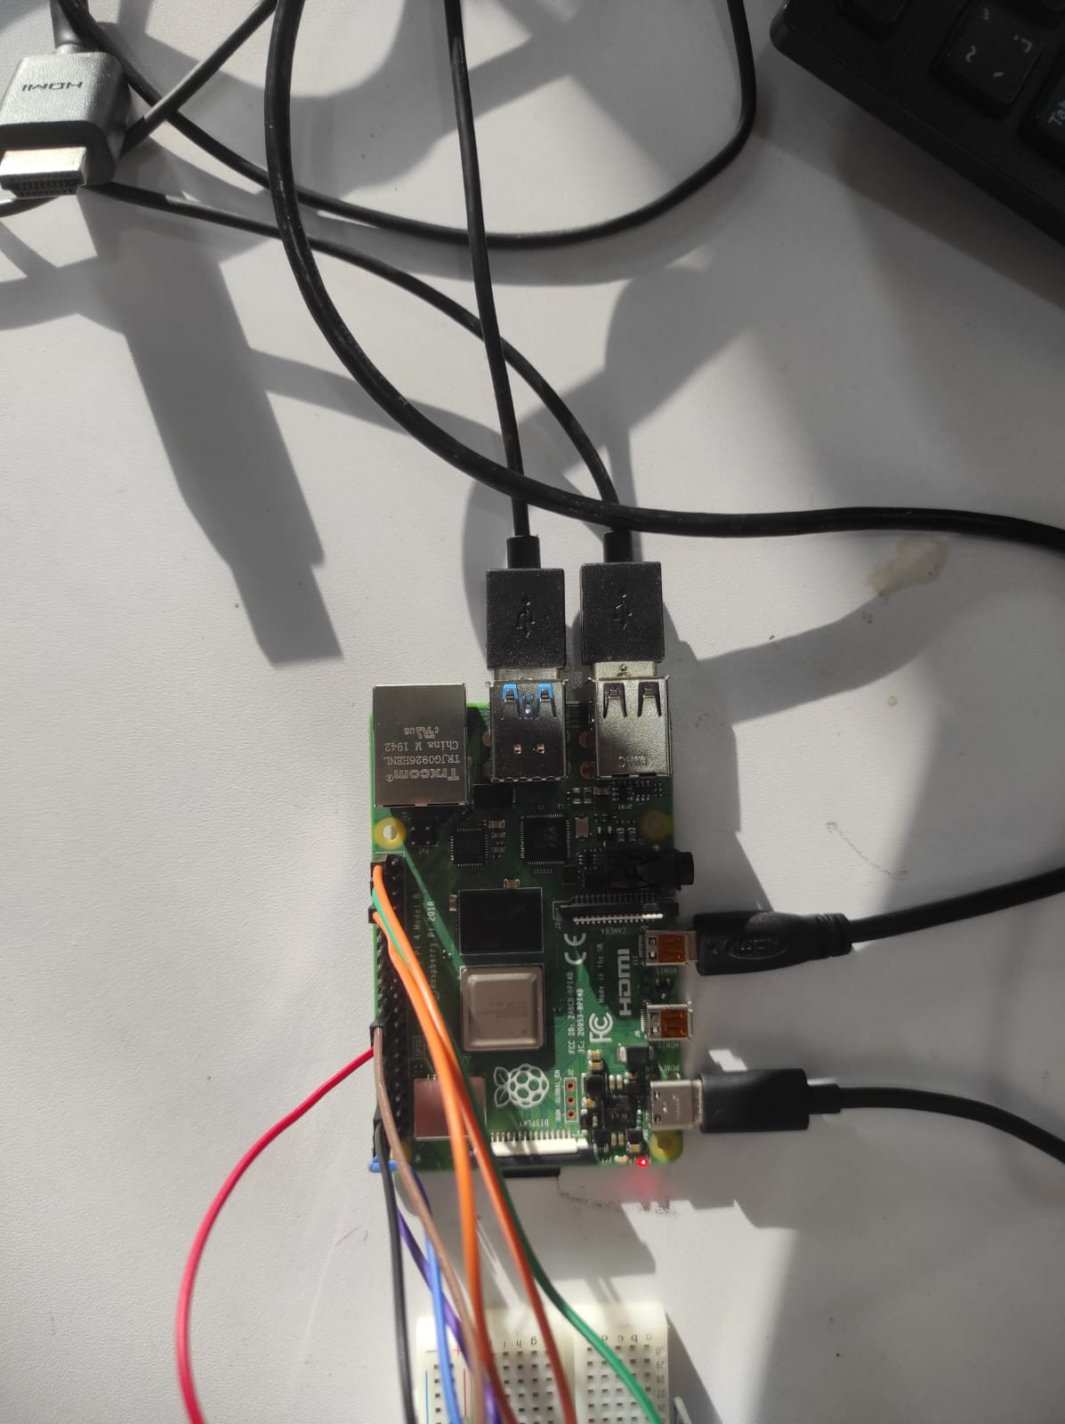
Connections

Slide 46
Video
We will show now a video to prove that the ultrasonic model worked

Slide 47


